Slide 1
CMSC201
Computer Science I for Majors
Lecture 04 – Decision Structures

Slide 2
Last Class We Covered
Python’s operators
  Arithmetic operators
    Mod and integer division
  Assignment operators
  Comparison operators
  Boolean operators
The order of operations

Slide 3
Any Questions from Last Time?

Slide 4
Today’s Objectives
To get practice using the Boolean data type
To understand how to use decision structures
  One-way (using if)
  Two-way (using if and else)
  Multi-way (using if, elif, and else)
To learn about nested decision structures

Slide 5
Quick Note about main()

Slide 6
main()
In Lab 2, we introduced the code
  def main():
  as the first line of code in our file
main() is an example of a function
We can use functions to organize our code
  We’ll cover them in detail later this semester

Slide 7
Functions
For now, think of functions as
something similar to a variable
  Variables hold data
  Functions hold code
We use the variable’s name to access its data
We use the function’s name to access its code

Slide 8
Using main() for Your Code
From now on, use main() in your code
  Every file in your HW1 should have main()
  def main():
  className = input("What class is this? ")
  print(className, "is awesome!")
  main()
declaring our main() function
calling our main() function

Slide 9
Control Structures

Slide 10
Control Structures
Structures that control how the program “flows” or operates, and in what order
Sequence
Decision Making
Looping
✓
we’ve already seen this
what we’re covering today

Slide 11
Sequence
One step after another,
with no choices to make
Homework 1 will be full of these
What are some real life examples?
  Dialing a phone number
  Purchasing and paying for groceries
statement 1
statement 2
.
.
.
statement N

Slide 12
Decision Making
Selecting one choice from many based
on a specific reason or condition
  If something is true, do A … if it’s not, do B
Some real life examples?
  What homework
  to work on tonight
  Choosing where
  to eat lunch
True
expression
False
statement 1
statement 2

Slide 13
Decision Making
Why did we spend so much time on comparison operators and logical
operators last time?
Because we can use them to control how
our program works and what code it runs
  By using the decision structures

Slide 14
One-Way Decision Structures

Slide 15
One-Way Decision Structures
Decision structures let Python make choices
  Based on some condition
def main():
weight = float(input("How heavy is your bag? "))
if weight > 50:
print("That bag is too heavy.")
print("There will be a $25 charge.")
print("Thank you for your business.")
main()

Slide 16
“if” Statements
The Python if statement is used to implement the decision
  if <condition>:
  <body>
The condition must evaluate to True or False
The body is a sequence of one or more
statements indented under the if heading

Slide 17
Formatting Decision Structures
Each if statement must close with a colon
  Two vertical dots (:)
Code in the body (that is executed as part of the if statement) must be indented
  By four spaces
  Hitting the “Tab” key in many editors (including emacs) will automatically indent it by four spaces

Slide 18
“if” Semantics
The semantics of the if should be clear
  First, the condition in the heading is evaluated
  If the condition is True
    The statements in the body are executed
    Control passes to the next statement in the program
  If the condition is False
    The statements in the body are skipped
    Control passes to the next statement in the program

Slide 19
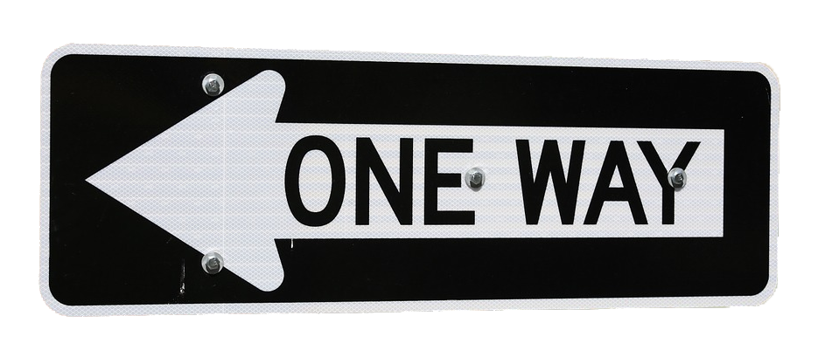
One-Way Decisions
The body of the if either executes or not depending on the condition
Control then passes to the next (non-body) statement after the if
This is a one-way
or simple decision

Slide 20
One-Way Example: Temperature
You’re studying abroad, and need to convert the temperature from Celsius to Fahrenheit
def main():
celsius = float(input("What is temp in Celsius? "))
fahrenheit = 9/5 * celsius + 32
print("The temperature is", fahrenheit, \
"degrees Fahrenheit.")
main()

Slide 21
Temperature Warnings
Let’s now modify the program to print a warning when the weather is extreme
Any temperature that is…
  Over 95 degrees Fahrenheit
    Will cause a hot weather warning
  Lower than 32 degrees Fahrenheit
    Will cause a cold weather warning

Slide 22
Temperature Example Code
def main():
celsius = float(input("What is temp in Celsius? "))
fahrenheit = 9 / 5 * celsius + 32
print("The temperature is", fahrenheit, \
"degrees Fahrenheit.")
if fahrenheit > 95:
print("It's really hot out there, be careful!")
if fahrenheit < 32:
print("Brrrrr. Be sure to dress warmly!")
main()

Slide 23
Temperature Example Code
def main():
celsius = float(input("What is temp in Celsius? "))
fahrenheit = 9 / 5 * celsius + 32
print("The temperature is", fahrenheit, \
"degrees Fahrenheit.")
if fahrenheit > 95:
print("It's really hot out there, be careful!")
if fahrenheit < 32:
print("Brrrrr. Be sure to dress warmly!")
main()
this is the main level of our program
this level of the code is only executed if fahrenheit > 95
this level of the code is only executed if fahrenheit < 32

Slide 24
Two-Way Decision Structures

Slide 25
Two-Way Decisions
In Python, a two-way decision can be used by adding an else clause onto an if clause
This is called an if-else decision structure:
if <condition>:
<codeA statements>
else:
<codeB statements>

Slide 26
How Python Handles if-else
Python will evaluate the condition, and then…
  If the condition is True, the set of codeA
  statements under the if are executed
  If the condition is False, the set of codeB
  statements under the else are executed
The code that comes after the if-else is executed only after one of the sets of statements is executed

Slide 27

Two-Way Code Framework
if theCondition:
<codeA statements>
else:
<codeB statements>
Only execute codeA if theCondition is True
If theCondition is not True, run codeB

Slide 28
Simple Two-Way Example
def main():
x = int(input("What is the value of X? "))
if x > 5:
print("X is larger than five!")
else:
print("X is less than or equal to five!")
main()
only one of these will execute
this is the main level of our program
this statement is
only executed if
x > 5 is True
this statement is
only executed if
x > 5 is False

Slide 29
Simple Two-Way Example #2
def main():
num = int(input("Enter a number: "))
if num % 2 == 0:
print("Your number is even.")
else:
print("Your number is odd.")
print(num, "is a good number!")
main()
when is this line executed?

Slide 30
Multi-Way Decision Structures

Slide 31
Bigger (and Better) Decision Structures
One-way and two-way structures are limited
What if we have multiple exclusive outcomes?
  Exclusive outcomes do not overlap with each other
  e.g., value of a playing card, letter grade in a class
What could we use to represent these?

Slide 32
“elif” Statements
The Python elif statement is used to handle additional exclusive conditions
  Must have a “starting” if statement
  The elif statements must have a condition
short for
“else if”
  if <condition1>:
  <codeA statements>
  elif <condition2>:
  <codeB statements>

Slide 33

Multi-Way Code Framework
if <condition1>:
<codeA statements>
elif <condition2>:
<codeB statements>
elif <condition3>:
<codeC statements>
# more "elif" statements if needed
else:
<codeD statements>
as many “elif” cases as are needed
“else” statement is optional

Slide 34
Multi-Way Decision Example
A computer science professor gives a five-point quiz at the beginning of every class
Possible grades are as follows:
  5 points: A 3 points: C 1 point: F
  4 points: B 2 points: D 0 points: F
To print out the letter grade based on the raw points, what would the code need to look like?

Slide 35
Multi-Way Decision Solution
def main():
score = int(input("Your quiz score out of 5: "))
if score == 5:
print("You earned an A")
elif score == 4:
print("You earned a B")
elif score == 3:
print("You earned a C")
elif score == 2:
print("You earned a D")
else:
print("You failed the quiz")
main()

Slide 36
Multi-Way Decision Solution
def main():
score = int(input("Your quiz score out of 5: "))
if score == 5:
print("You earned an A")
elif score == 4:
print("You earned a B")
elif score == 3:
print("You earned a C")
elif score == 2:
print("You earned a D")
else:
print("You failed the quiz")
main()
these are five
separate statements
since this is an
if-elif-else block, only one of the five statements
will be executed

Slide 37
Multi-Way Decision Solution
def main():
score = int(input("Your quiz score out of 5: "))
if score == 5:
print("You earned an A")
elif score == 4:
print("You earned a B")
elif score == 3:
print("You earned a C")
elif score == 2:
print("You earned a D")
else:
print("You failed the quiz")
main()
How would you update this to handle floats?

Slide 38
Multi-Way Decision Solution
def main():
score = float(input("Your quiz score out of 5: "))
if score >= 5:
print("You earned an A")
elif score >= 4:
print("You earned a B")
elif score >= 3:
print("You earned a C")
elif score >= 2:
print("You earned a D")
else:
print("You failed the quiz")
main()
How would you update this to handle floats?
What would happen if we just used “if” statements instead?

Slide 39
Multi-Way Decision Solution
def main():
score = float(input("Your quiz score out of 5: "))
if score >= 5:
print("You earned an A")
if score >= 4:
print("You earned a B")
if score >= 3:
print("You earned a C")
if score >= 2:
print("You earned a D")
else:
print("You failed the quiz")
main()
What would print out for a score of 5?
You earned an A
You earned a B
You earned a C
You earned a D
Using only “if” statements give us the wrong answer!

Slide 40
Exclusive Conditions
Using the if-elif-else block lets you have
exclusive conditions more easily
  No need to check if score < 5 and score >= 4
Also, with a block, the else is only used if none of the other conditionals are True
The if-elif-else block is evaluated from the top down, so the order of statements does matter

Slide 41
Nested Decision Structures

Slide 42
Nested Decision Structures
Up until now, we have only used a
single level of decision making
What if we want to make decisions
within decisions?
These are called nested decision structures

Slide 43
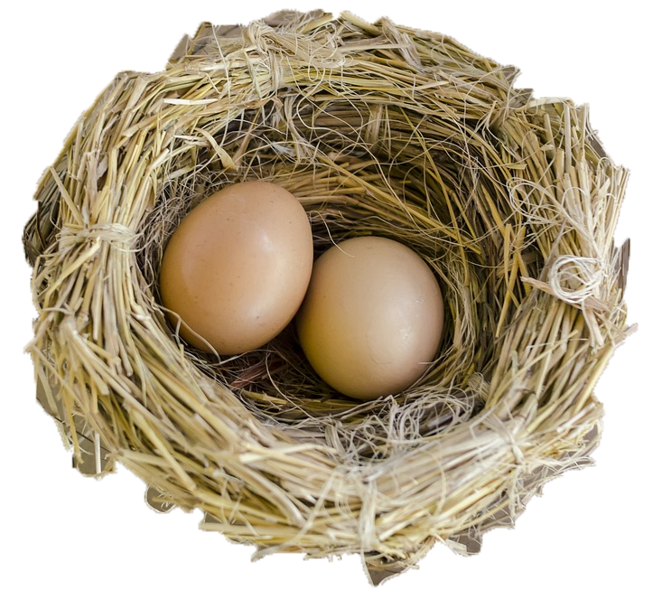
Nested Decision Structures
Python allows you to nest decision structures
  As many levels deep as you want
  Nesting can occur inside if,
  elif, or else statements
Only “rule” is that every inside
level must start with an “if”
  Having matching elifs or
  an else is not required

Slide 44
Nested Decision Structure Example
For example, we may
  Ask the user if they have a pet
  if they have a pet
    Ask the user what type of pet
    if they have a dog, take it for a walk
    elif they have a cat, clean the litter box
    else clean the cage/stable/tank

Slide 45
Nested Decision Structure Example
def main():
ans = input("Do you have a pet? (yes/no) ")
if ans != "no":
pet = input("What kind of pet do you have? ")
if pet == "dog":
print("Take it for a walk")
elif pet == "cat":
print("Clean the litter box")
else:
print("Clean the cage/stable/tank")
main()

Slide 46
Nested Decision Structures Code
if <condition1>:
if <condition2>:
<codeA statements>
elif <condition3>:
<codeB statements>
else:
<codeC statements>
else:
<codeD>

Slide 47
Nested Decision Structures Code
this is the main level of our program:
an if-else block
if <condition1>:
if <condition2>:
<codeA statements>
elif <condition3>:
<codeB statements>
else:
<codeC statements>
else:
<codeD>
this is the next level, inside the first
if statement
codeA, codeB, and codeC are separate statements
since this is an
if-elif-else block, only one of them will be executed
if condition1 was false, Python will go straight here and execute codeD

Slide 48
Nested Decision Structure Example
You recently took a part-time job to help pay for your student loans at a local cell phone store
If you sell at least $1000 worth of phones in a pay period, you get a bonus
  Your bonus is 3% if you sold at least 3 iPhones, otherwise your bonus is only 2%

Slide 49
Nested Decision Solution
def main():
totalSales = float(input("Please enter your total sales:"))
if totalSales >= 1000.00:
# only ask this if they are eligible for a bonus
iPhonesSold = int(input("Enter the number of iPhones sold:"))
if iPhonesSold >= 3:
bonus = totalSales * 0.03
else:
bonus = totalSales * 0.02
print("Your bonus is $", bonus)
else:
print("Sorry, you do not get a bonus this pay period.")
main()

Slide 50
Daily emacs Shortcut
CTRL+A
  Moves your cursor to the front of the line
  (To remember: A is at the front of the alphabet)
CTRL+E
  Moves your cursor to the end of the line
  (To remember: E stands for “end”)

Slide 51
Announcements
HW 0 is due Friday, February 9th at 8:59:59 PM
HW 1 will come out on Saturday, February 10th
  Due by Friday (February 16th) at 8:59:59 PM
  You must first complete the
  Syllabus and Course Website Quiz to see it
Pre Lab 3 Quiz will come out Friday @ 10 AM
  Must be completed by 10 AM Monday morning

Slide 52
Image Sources
One way sign (adapted from):
  https://pixabay.com/p-438122
Splitting arrow:
  https://pixabay.com/p-154512/
Three decisions:
  https://pixabay.com/p-1020289/
Nest with eggs (adapted from):
  https://pixabay.com/p-1485378

